Slide 1
Is there potential for California alfalfa production to be climate neutral?
Gina Nichols^{1,2}, Dan Putnam¹, Cameron Pittelkow¹
¹University of California, Davis ²The Land Institute
International Symposium on Sustainable Systems and Technology – ISSST 2023
June 2023, Ft. Collins CO

Slide 2
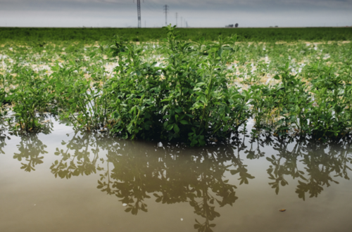

Slide 3
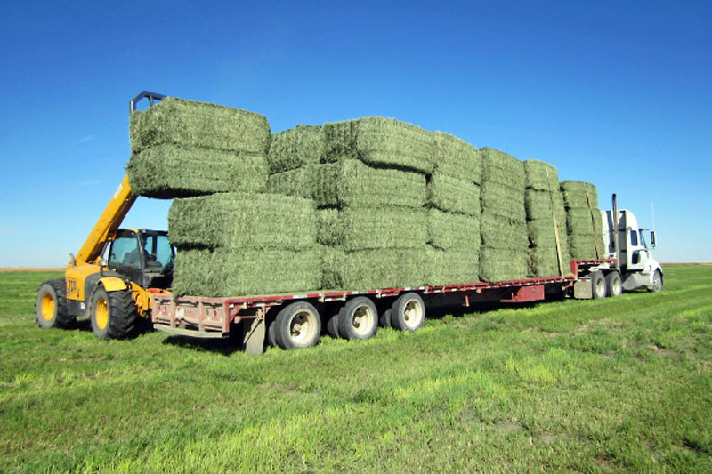
https://www.beeculture.com/catch-the-buzz-dairy-alfalfa-doesnt-get-to-bloom-but-beef-alfalfa-does-where-to-put-your-bees-is-simple/

Slide 4
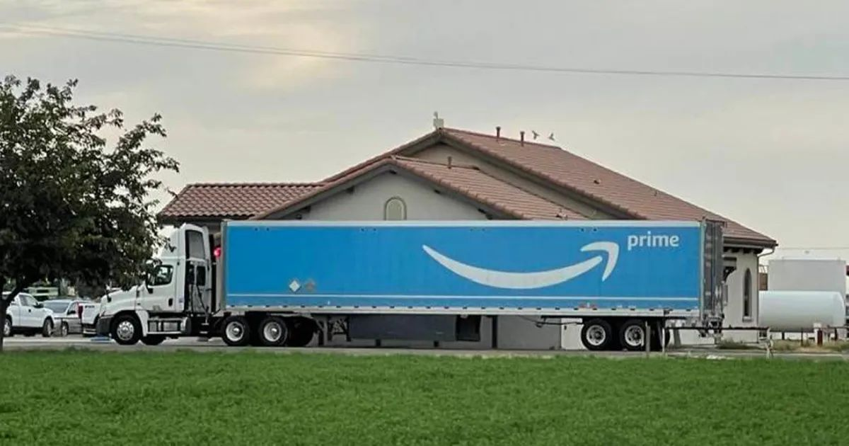
https://www.beeculture.com/catch-the-buzz-dairy-alfalfa-doesnt-get-to-bloom-but-beef-alfalfa-does-where-to-put-your-bees-is-simple/
https://westernagnetwork.com/premium-alfalfa-hay-delivered-by-amazon-prime

Slide 5
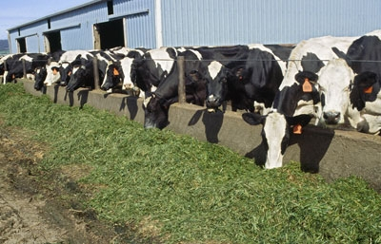
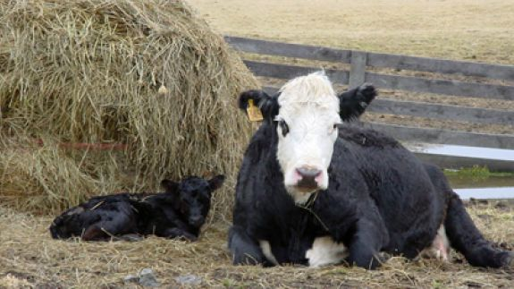

Slide 6
Narrow lens:
Not a great Californian crop

Slide 7
Narrow lens:
Not a great Californian crop
Broader lens:
Is that true?

Slide 8
Motivation
Methodology
Learnings

Slide 9
Motivation
Methodology
Learnings

Slide 10
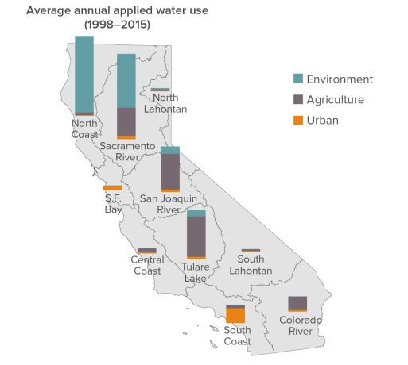
Motivation
Methodology
Learnings
Data from Department of Water Resources 2018, Figure from Public Policy Institute of California Fact Sheet
https://cwc.ca.gov/-/media/CWC-Website/Files/Documents/2019/06_June/June2019_Item_12_Attach_2_PPICFactSheets.pdf
Notes:
Environment includes water for ‘wild and scenic rivers’, required delta outflow, instream flows, managed wetlands. Ag includes water for crop production

Slide 11
Motivation
Methodology
Learnings

Slide 12
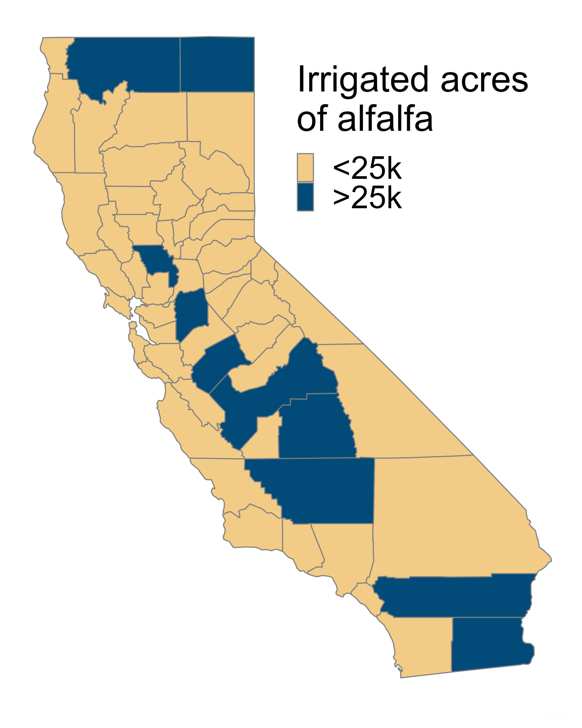
Motivation
Methodology
Learnings
Data from NASS 2017
Notes:
Environment includes water for ‘wild and scenic rivers’, required delta outflow, instream flows, managed wetlands. Ag includes water for crop production

Slide 13
Motivation
Methodology
Learnings
Notes:
Environment includes water for ‘wild and scenic rivers’, required delta outflow, instream flows, managed wetlands. Ag includes water for crop production

Slide 14
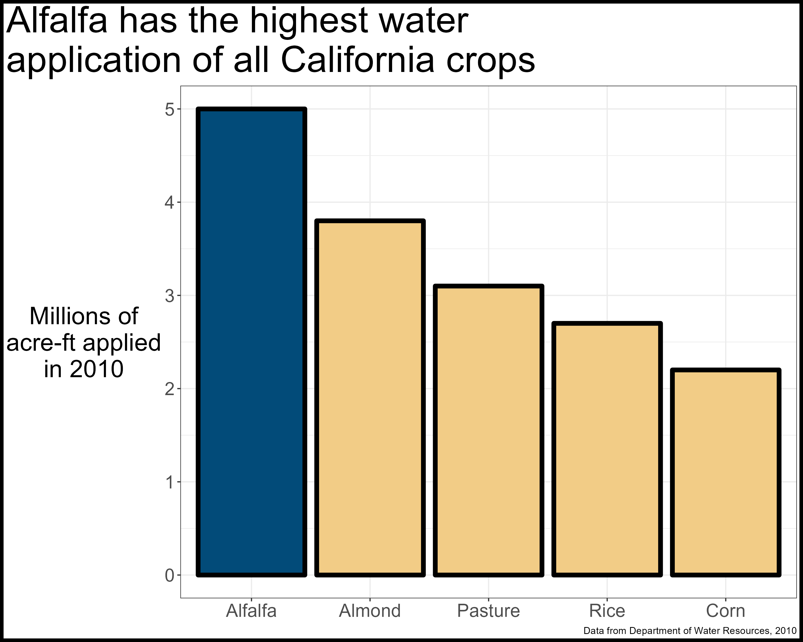
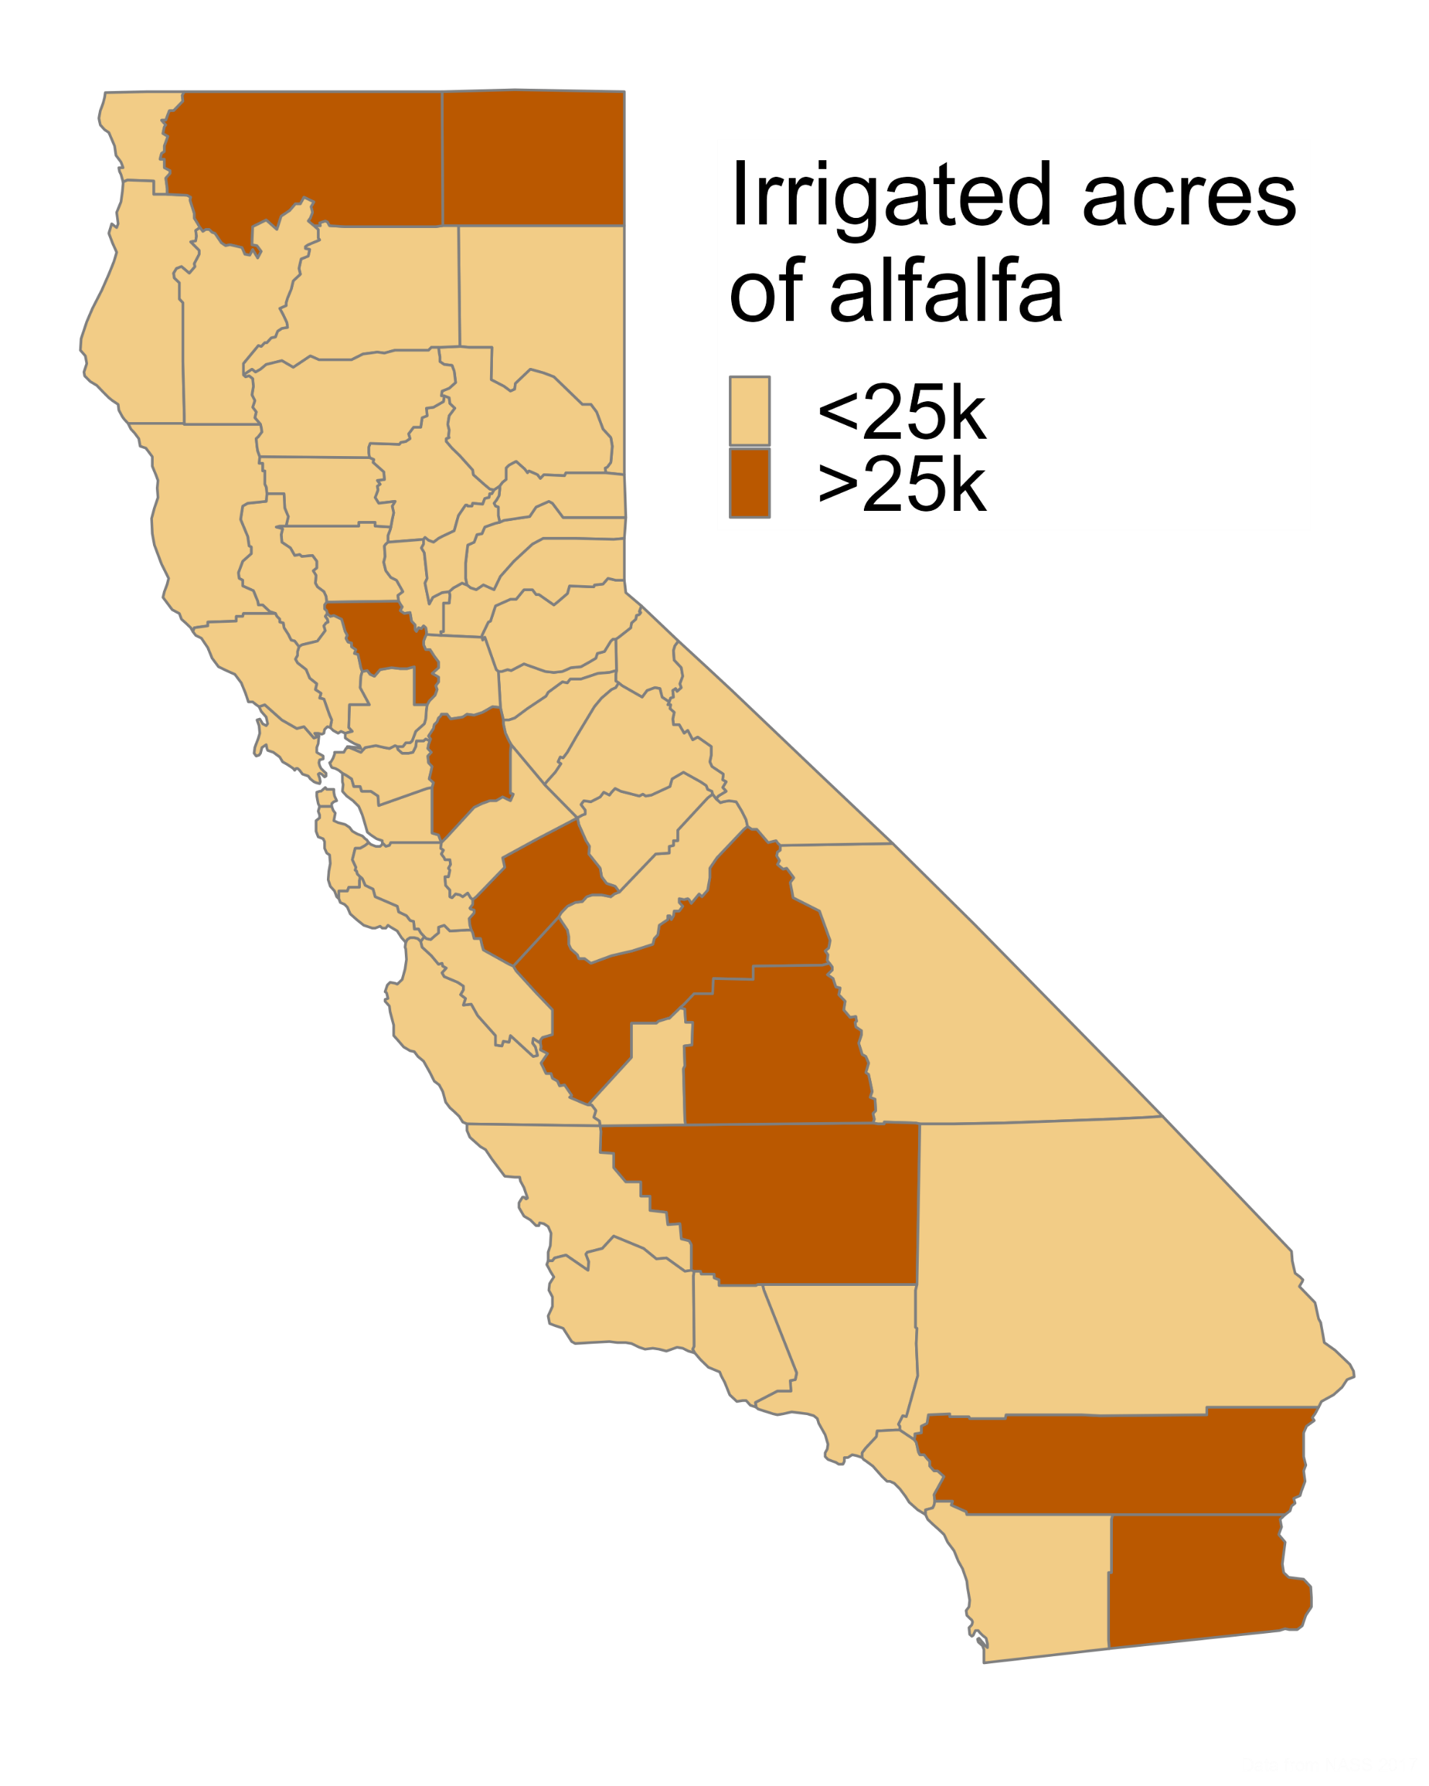
Motivation
Methodology
Learnings
Notes:
Environment includes water for ‘wild and scenic rivers’, required delta outflow, instream flows, managed wetlands. Ag includes water for crop production

Slide 15
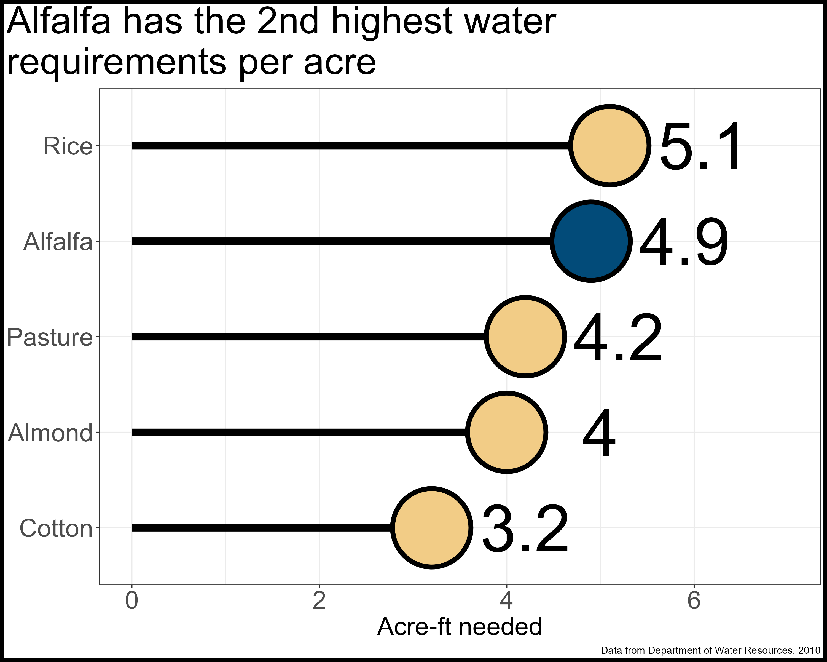
Motivation
Methodology
Learnings
Notes:
Environment includes water for ‘wild and scenic rivers’, required delta outflow, instream flows, managed wetlands. Ag includes water for crop production

Slide 16
Motivation
Methodology
Learnings

Slide 17
Motivation
Methodology
Learnings

Slide 18
Motivation
Methodology
Learnings

Slide 19
Motivation
Methodology
Learnings
Get rid of it.

Slide 20
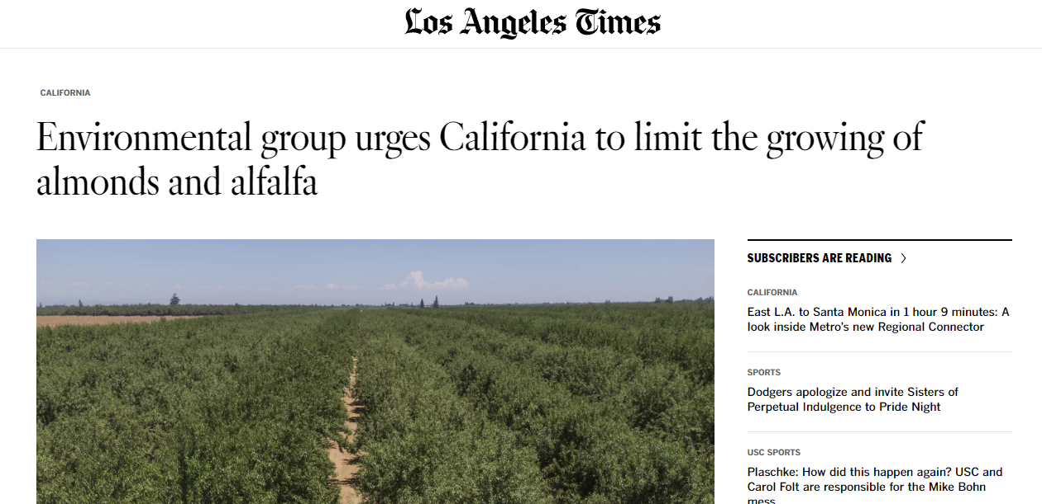
Motivation
Methodology
Learnings
https://phys.org/news/2023-02-environmental-group-urges-california-limit.html

Slide 21
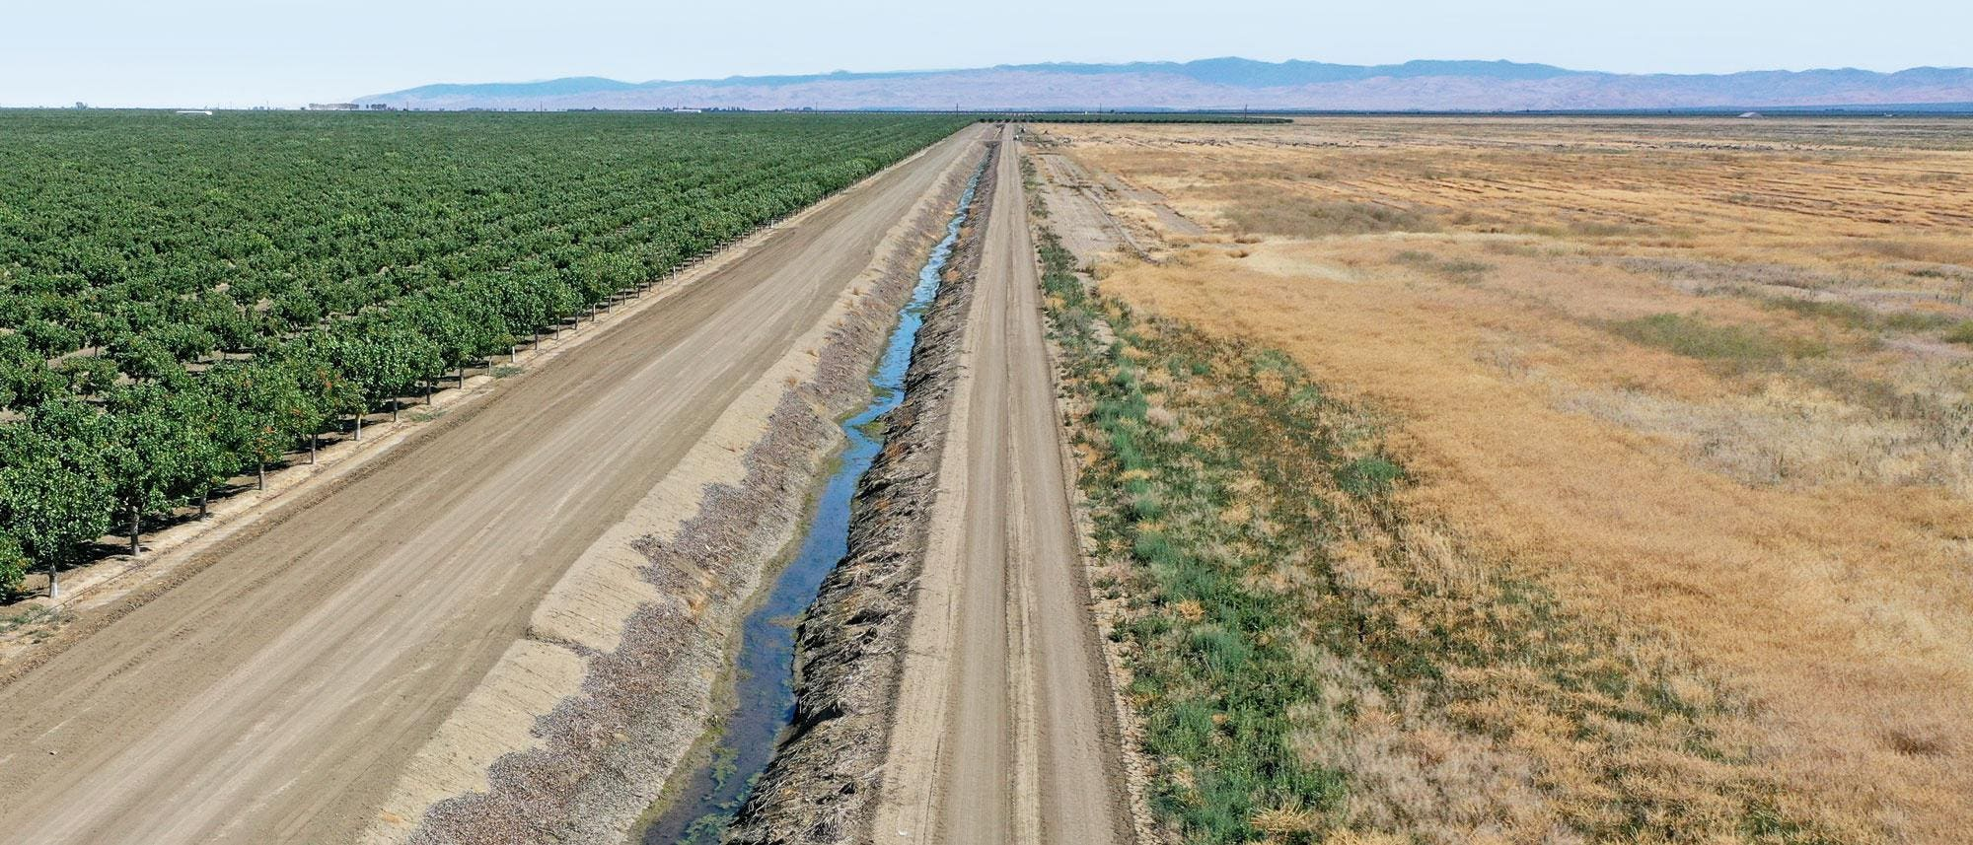
Motivation
Methodology
Learnings
https://www.forbes.com/sites/chloesorvino/2022/09/22/california-farms-pump-water-to-feed-crops-amid-extreme-heat-and-drought-but-residents-wells-are-running-dry/?sh=6550a2cd6eac

Slide 22

Motivation
Methodology
Learnings
One of the only wetland bird feeding areas left in California
Provides ‘free’ nitrogen to subsequent crop
Provides years without soil disturbance
Flexible water user

Slide 23

Motivation
Methodology
Learnings
Close proximity to dairies lowers transportation requirements
Lower yield variability compared to rainfed regions
Yields are consistently twice the US average

Slide 24
Motivation
Methodology
Learnings
?

Slide 25
Use Life Cycle Assessment methodologies to estimate climate impacts of California alfalfa production
Motivation
Methodology
Learnings

Slide 26
Motivation
Methodology
Learnings
Functional unit:
1 hectare-year of land (carbon emissions)
1 Mg of dry yield (carbon efficiency)
System boundaries:
Cradle to roadside (~80% of alfalfa is sold)
Impact factors:
Piece together from publicly available sources
Flows:
Enterprise budgets

Slide 27
Motivation
Methodology
Learnings
Functional unit:
1 hectare-year of land (carbon emissions)
1 Mg of dry yield (carbon efficiency)
System boundaries:
Cradle to roadside (~80% of alfalfa is sold)
Impact factors:
Piece together from publicly available sources
Flows:
Enterprise budgets

Slide 28
Motivation
Methodology
Learnings
Functional unit:
1 hectare-year of land (carbon emissions)
1 Mg of dry yield (carbon efficiency)
System boundaries:
Cradle to roadside (~80% of alfalfa is sold)
Impact factors:
Piece together from publicly available sources
Flows:
Enterprise budgets

Slide 29
Motivation
Methodology
Learnings
Functional unit:
1 hectare-year of land (carbon emissions)
1 Mg of dry yield (carbon efficiency)
System boundaries:
Cradle to roadside (~80% of alfalfa is sold)
Impact factors:
Piece together from publicly available sources
Flows:
Enterprise budgets

Slide 30
Motivation
Methodology
Learnings
Functional unit:
1 hectare-year of land (carbon emissions)
1 Mg of dry yield (carbon efficiency)
System boundaries:
Cradle to roadside (~80% of alfalfa is sold)
Impact factors:
Piece together from publicly available sources
Flows:
Enterprise budgets

Slide 31
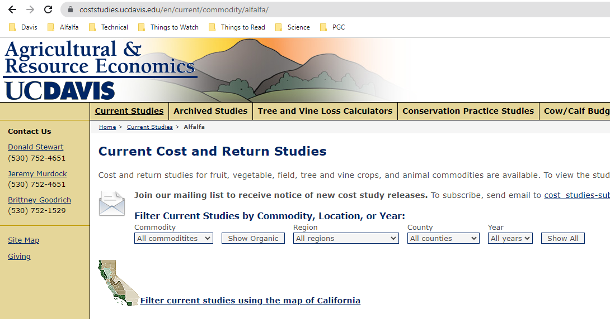
https://coststudies.ucdavis.edu/en/current/commodity/alfalfa/

Slide 32
Motivation
Methodology
Learnings
Functional unit:
1 hectare-year of land (carbon emissions)
1 Mg of dry yield (carbon efficiency)
System boundaries:
Cradle to roadside (~80% of alfalfa is sold)
Impact factors:
Piece together from publicly available sources
Flows:
Enterprise budgets

Slide 33
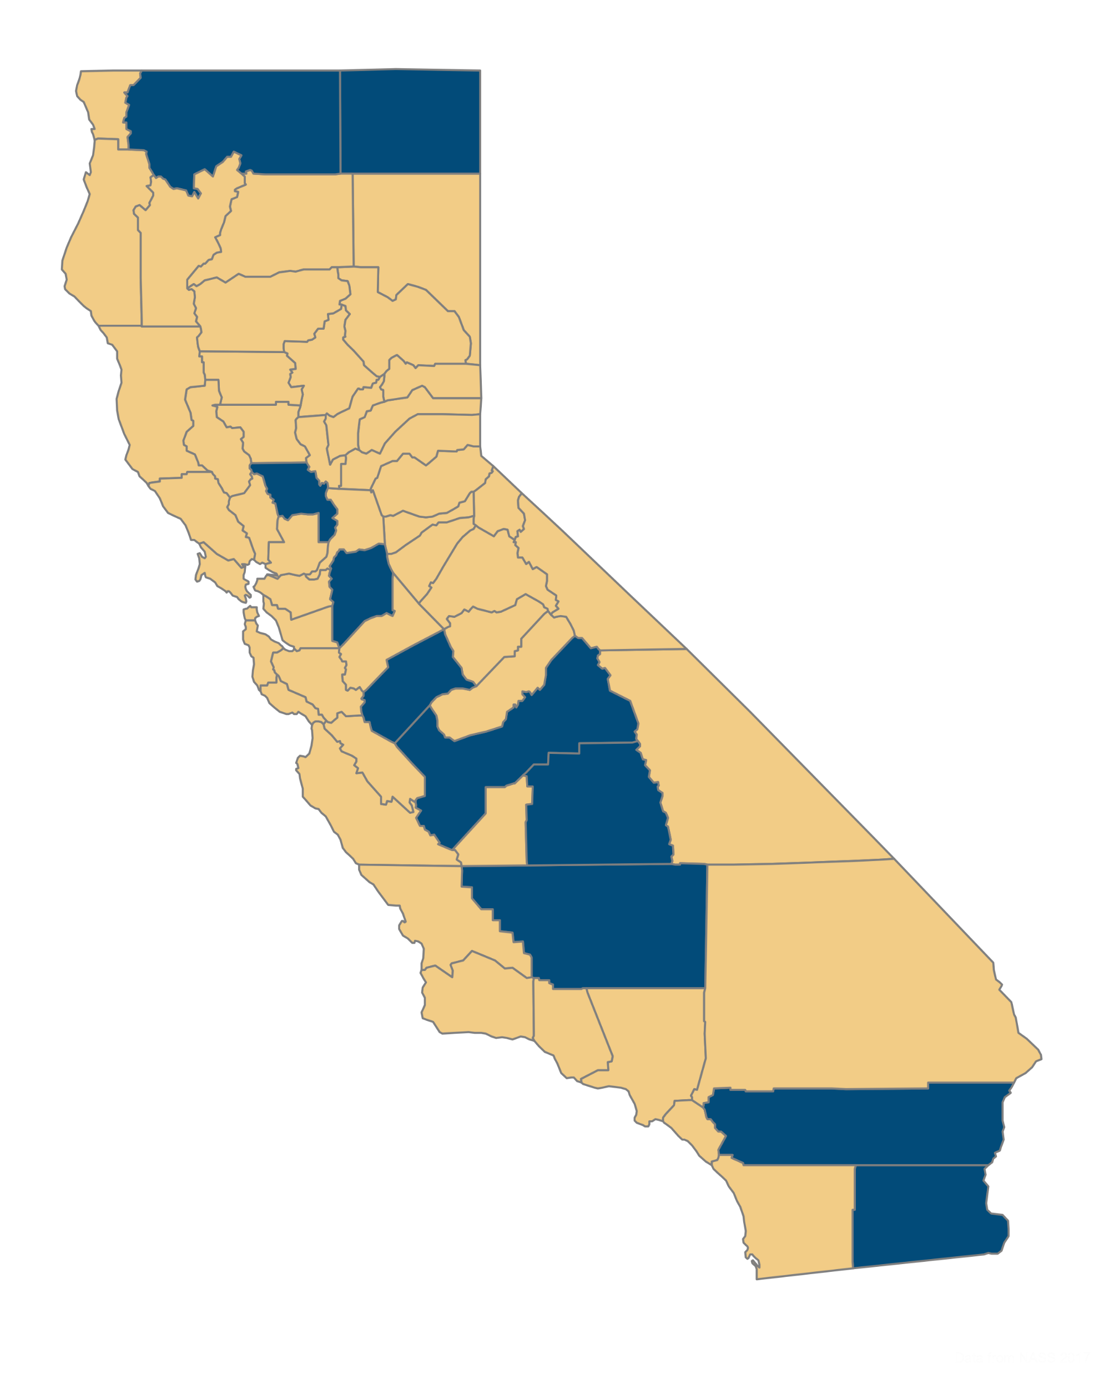
Motivation
Methodology
Learnings
Low input, low yields
Medium input, medium yields
High input, high yields

Slide 34
Motivation
Methodology
Learnings

Slide 35

Motivation
Methodology
Learnings
http://comet-planner-cdfahsp.com/

Slide 36
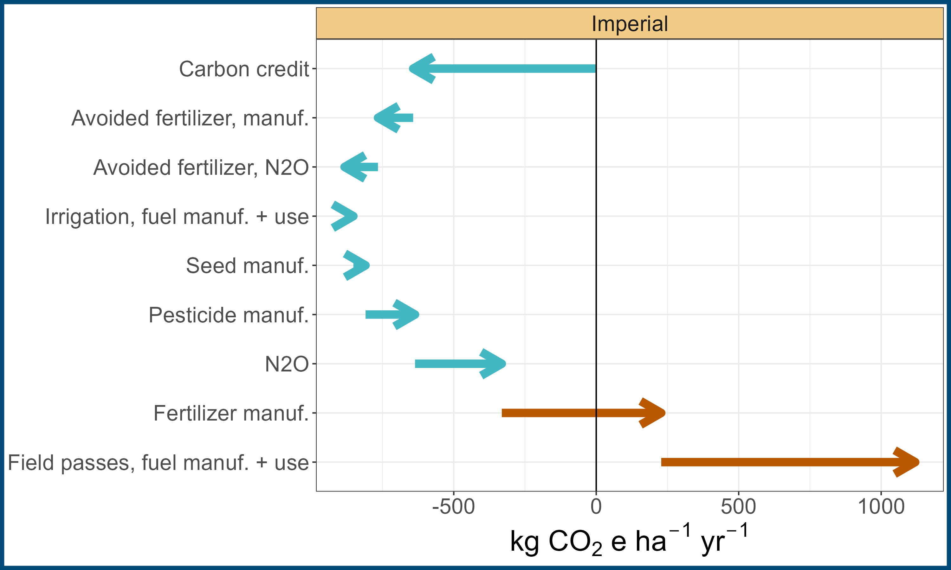
Motivation
Methodology
Learnings

Slide 37
Motivation
Methodology
Learnings

Slide 38
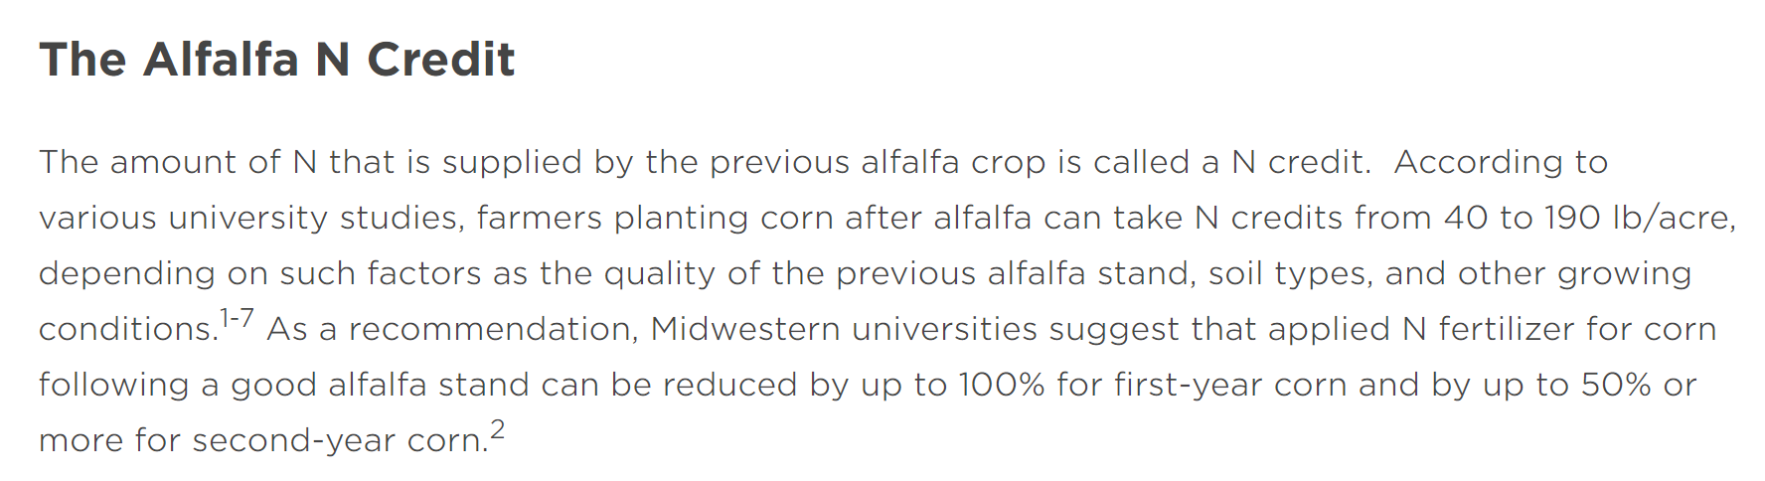





Fully account for cropping system impacts (Costa et al. 2020 Int J LCA)
https://www.channel.com/en-us/agronomy/determining_corn_fertilizer_requirements_following_an_alfalfa_crop.html

Slide 39
Motivation
Methodology
Learnings

Slide 40
Motivation
Methodology
Learnings

Slide 41
Motivation
Methodology
Learnings

Slide 42
Motivation
Methodology
Learnings

Slide 43
Motivation
Methodology
Learnings

Slide 44
Motivation
Methodology
Learnings

Slide 45
Motivation
Methodology
Learnings

Slide 46
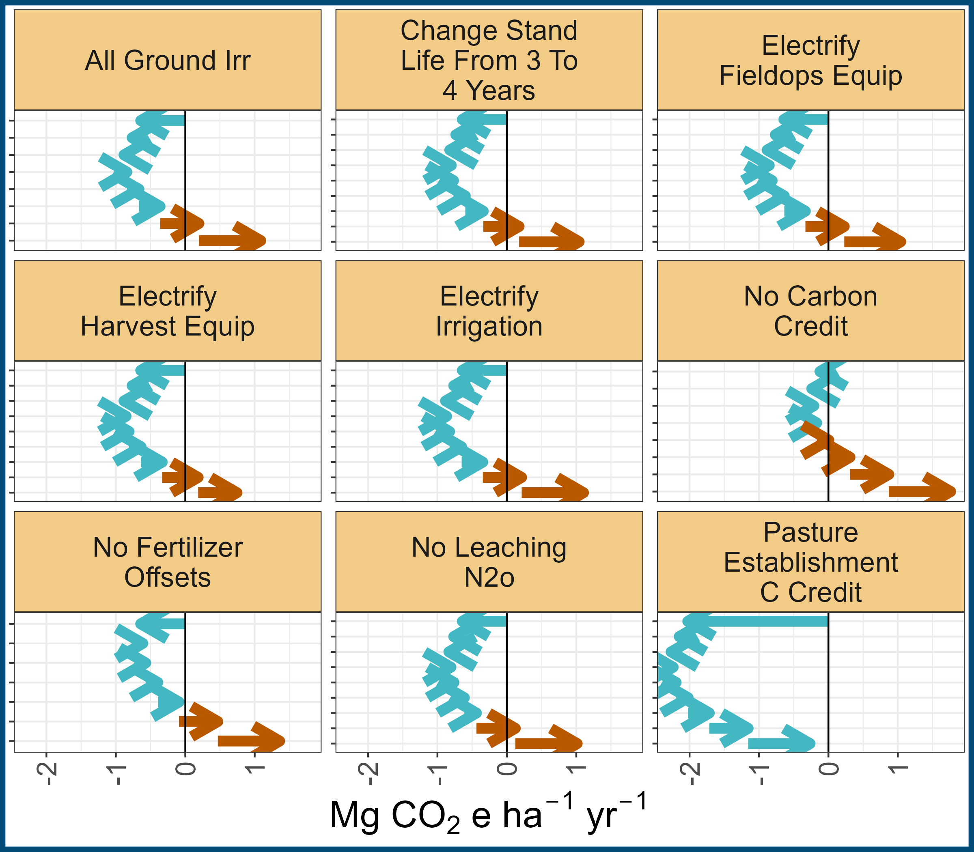
Motivation
Methodology
Learnings

Slide 47
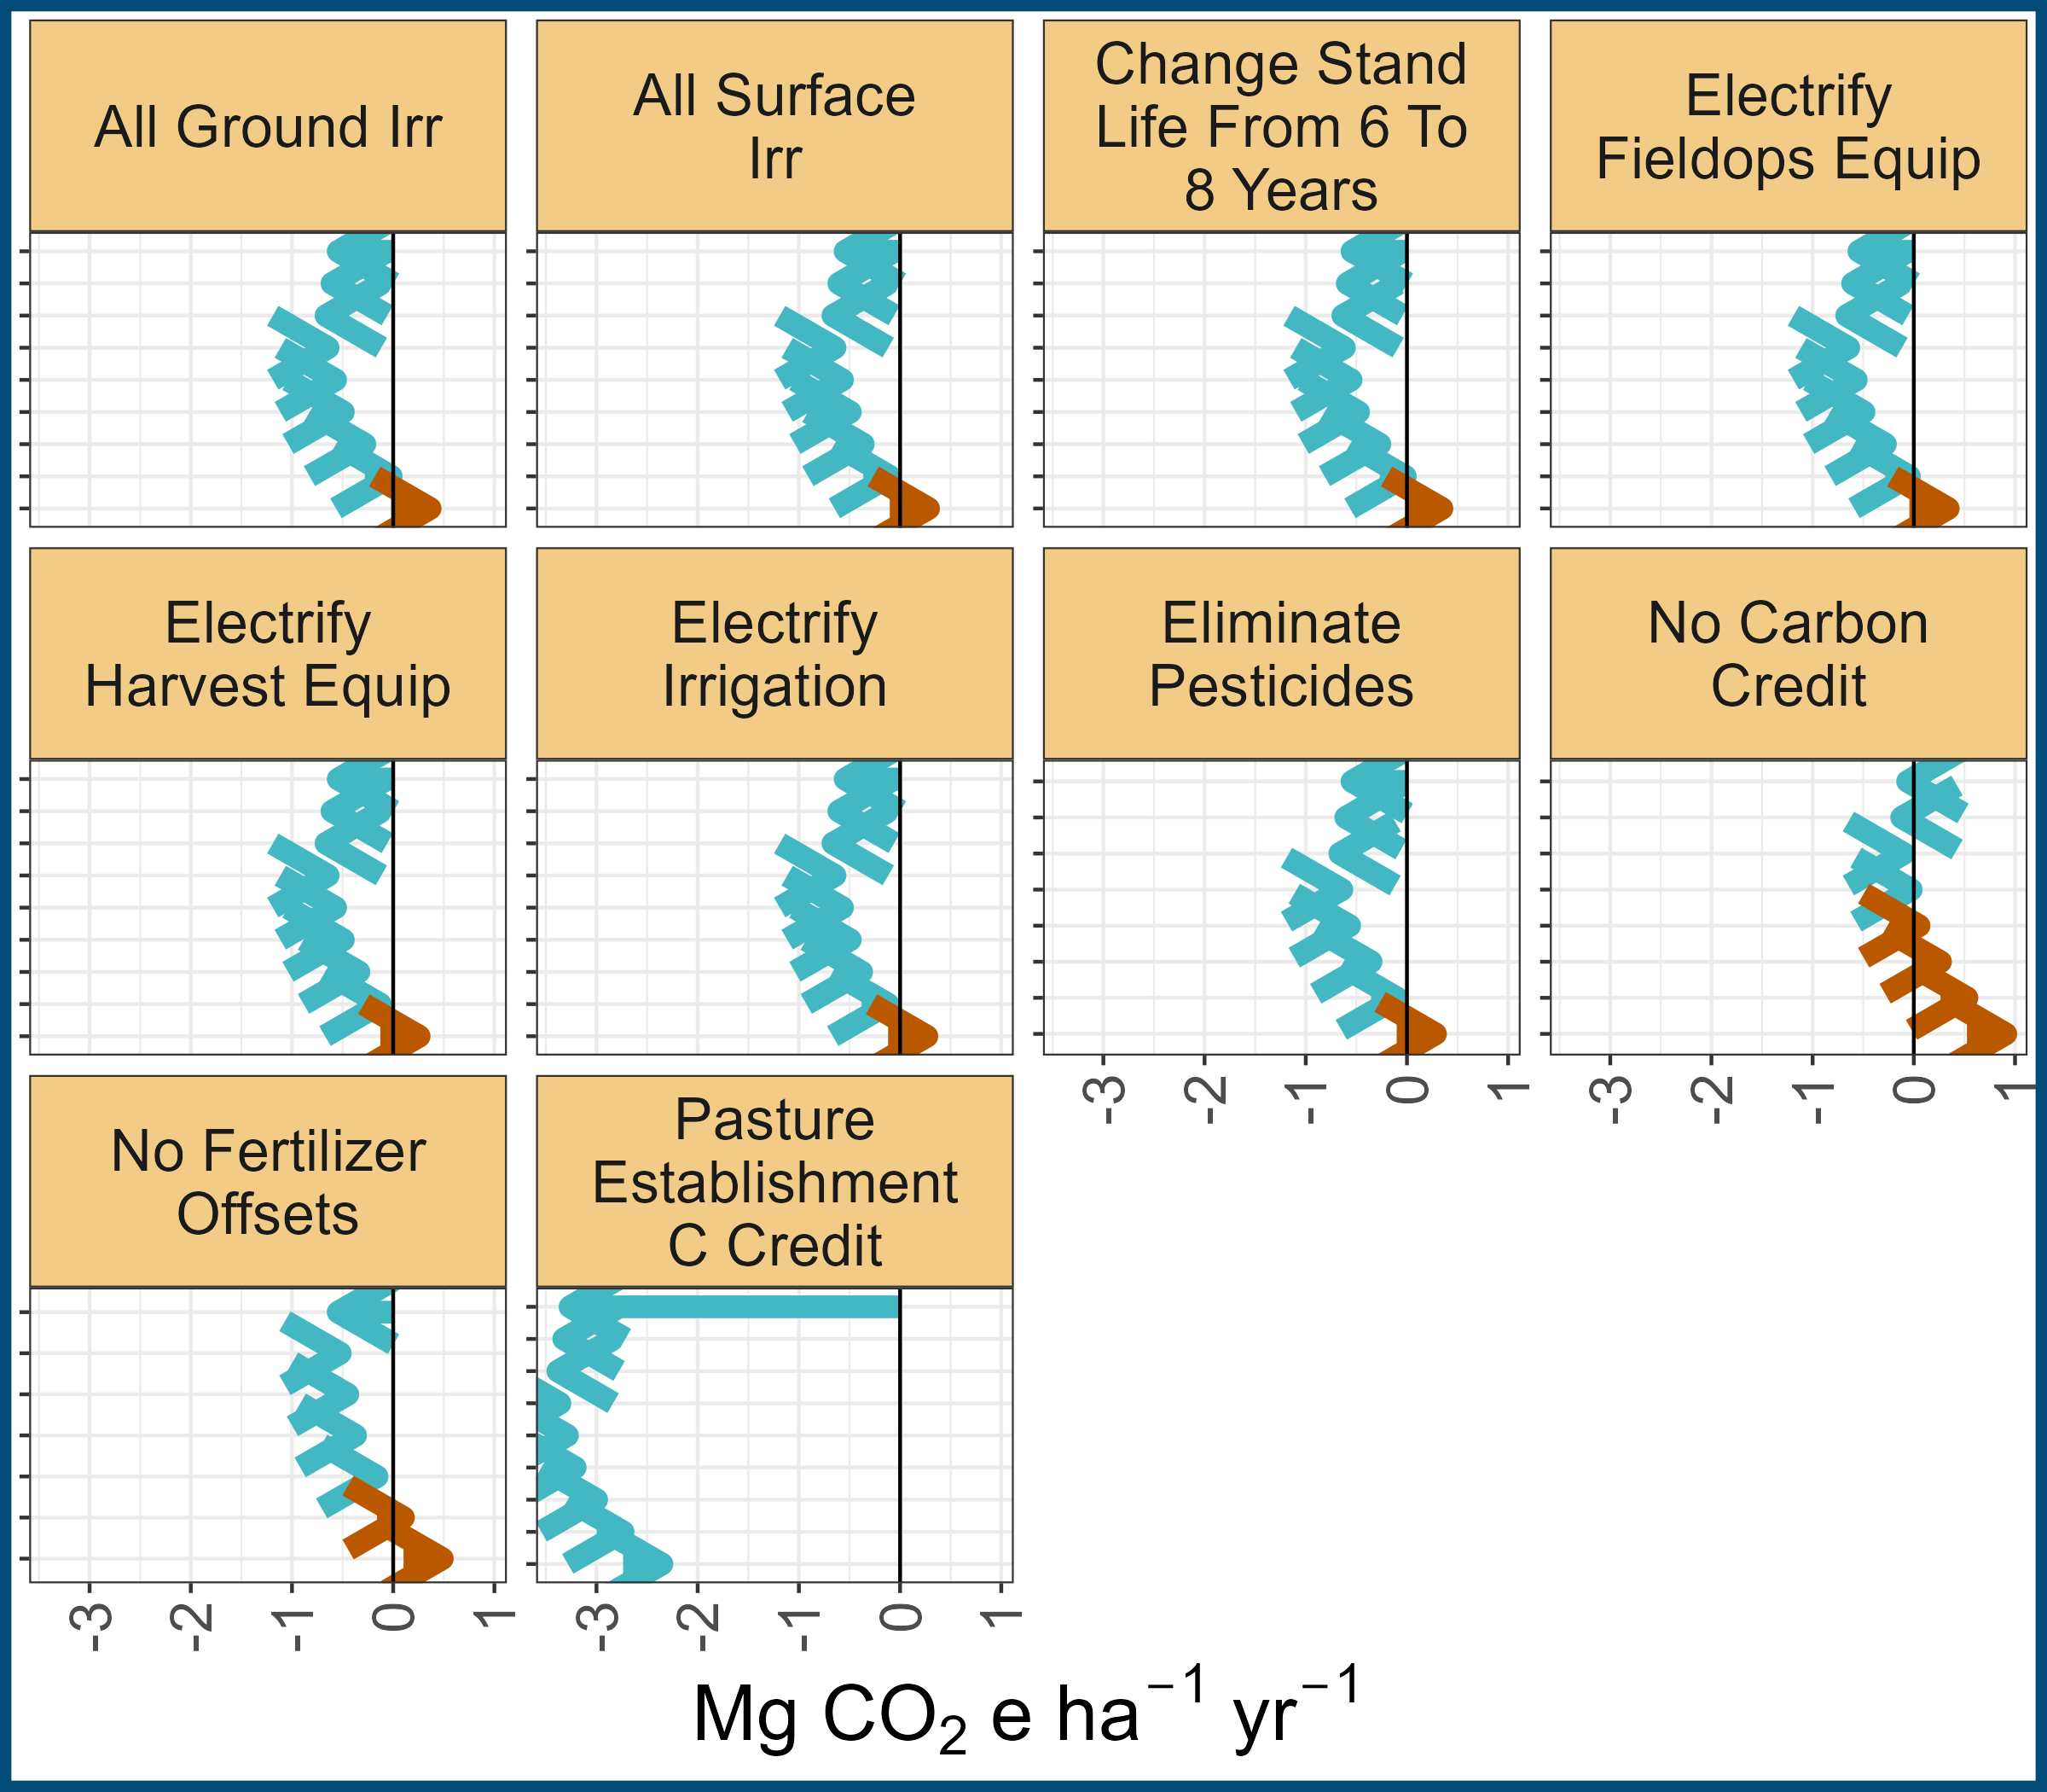
Motivation
Methodology
Learnings

Slide 48
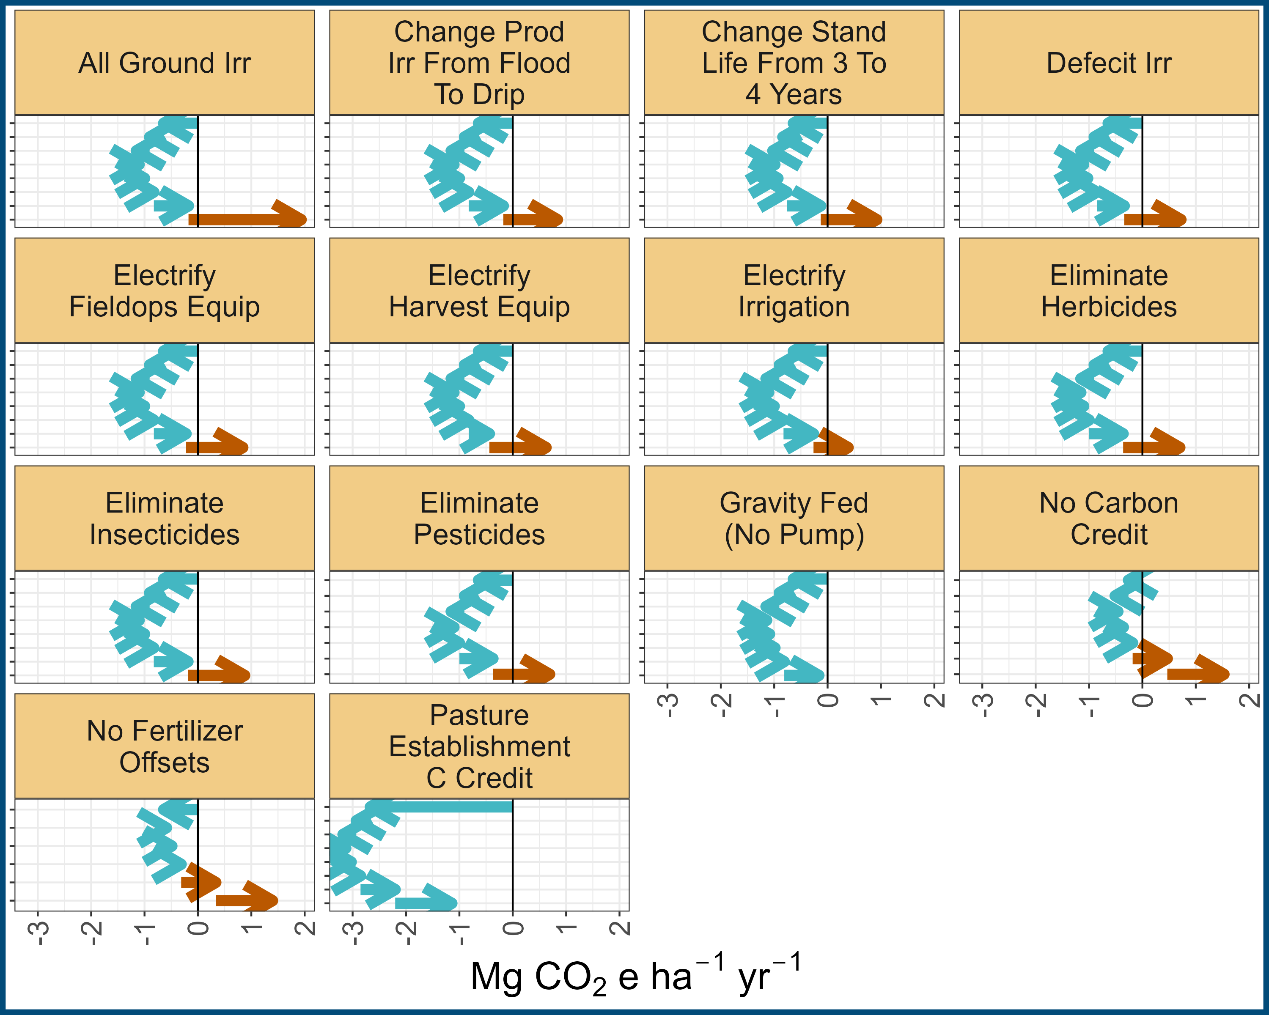
Motivation
Methodology
Learnings

Slide 49
Motivation
Methodology
Learnings

Slide 50
Motivation
Methodology
Learnings

Slide 51
Motivation
Methodology
Learnings
“It shall be the goal of the State to transition to 100% zero-emission off-road vehicles and equipment by 2035 where feasible.”
https://www.gov.ca.gov/2020/09/23/governor-newsom-announces-california-will-phase-out-gasoline-powered-cars-drastically-reduce-demand-for-fossil-fuel-in-californias-fight-against-climate-change/

Slide 52
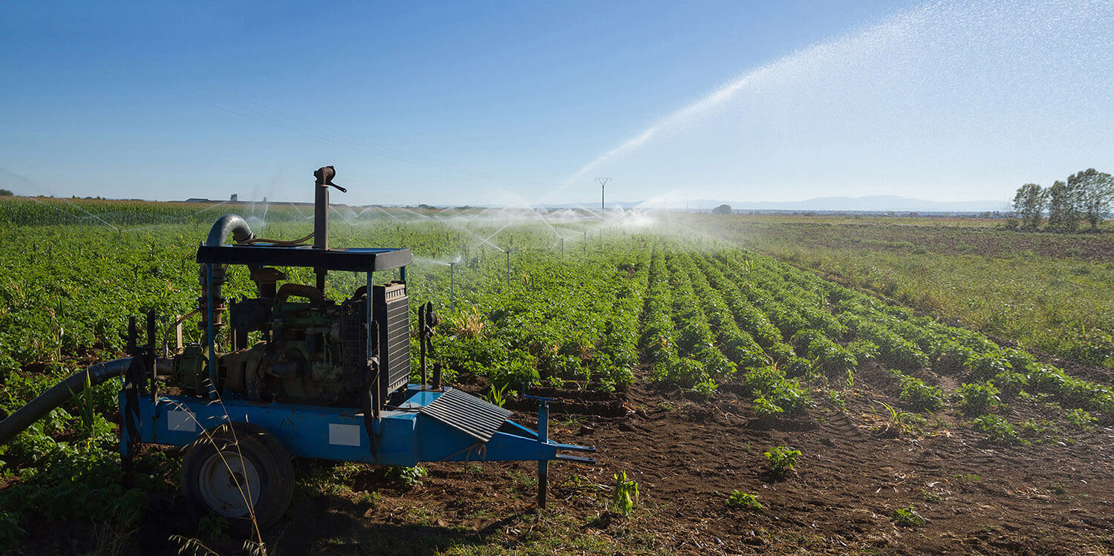
Motivation
Methodology
Learnings

Slide 53
Motivation
Methodology
Learnings
General rule of thumb: CA alfalfa emits ~1 Mg net CO₂e ha⁻¹ yr⁻¹
The carbon sequestration piece of alfalfa is significant
Restricting access to surface water has significant impact on energy use/GHG emissions
Focus groups/surveys could help create scenarios that are meaningful to producers…

Slide 54
Motivation
Methodology
Learnings
Impact factors:
Category | Description | Souce
Manufacturing | Fertilizers, pesticides, fuel | GREET, NRCS, Audsley et al. 2009)
Fuel use | Diesel, propane, electricity | EPA
Seed | Growing seed | Imperial County results
Soil emissions | Soil N₂O emissions | IPCC
Soil carbon changes | CO₂ sequestration/emissions | California Healthy Soils
Avoided fertilizer application | Avoided manufacturing of fertility products | GREET
Avoided soil emissions | Avoided soil N₂O emissions | IPCC

Slide 55
Motivation
Methodology
Learnings
http://comet-planner-cdfahsp.com/

Slide 56
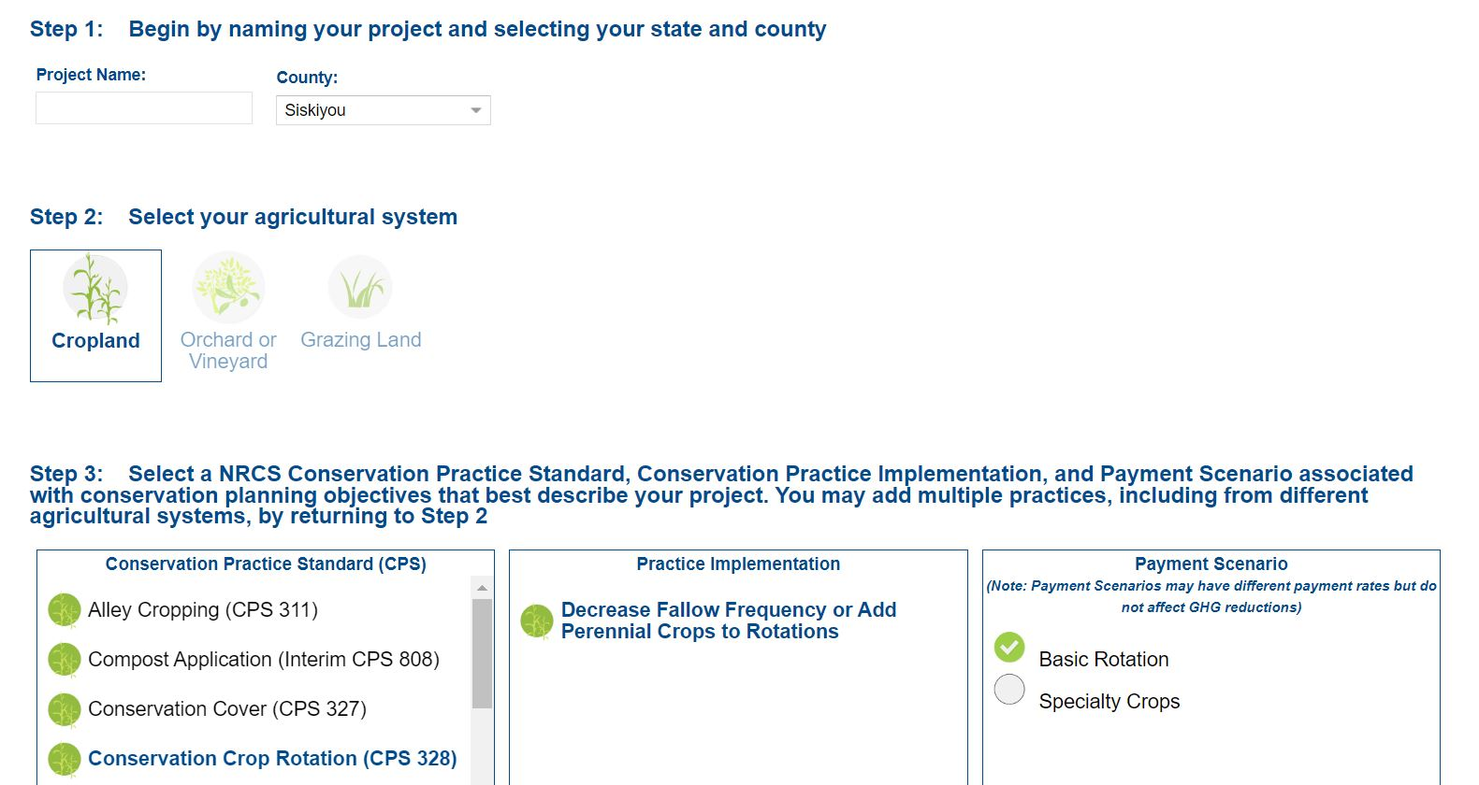
Motivation
Methodology
Learnings

Slide 57

Motivation
Methodology
Learnings

Slide 58
Motivation
Methodology
Learnings
Decrease fallow frequency or add perennial crops to rotations

Slide 59
Motivation
Methodology
Learnings
Sequester carbon and reduce nitrous oxide emissions

